Slide 6
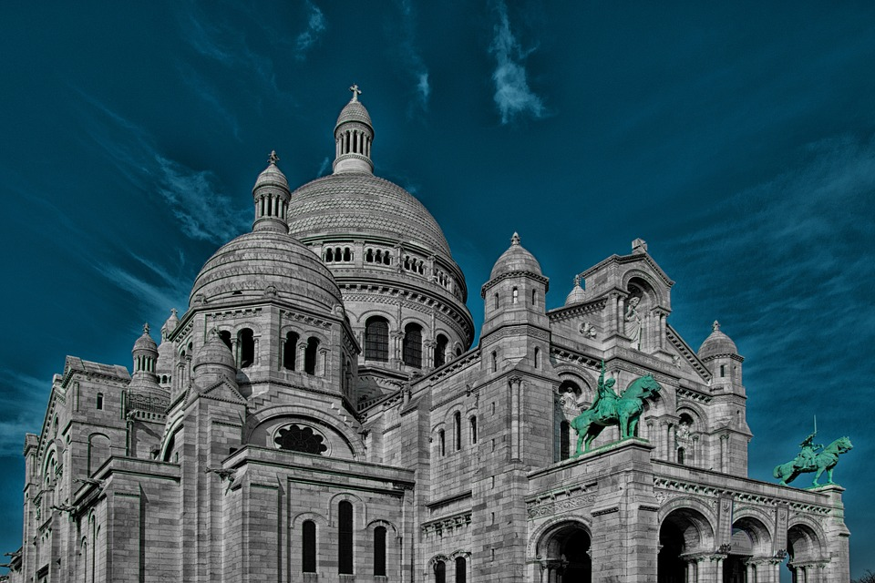

Text

Slide 8
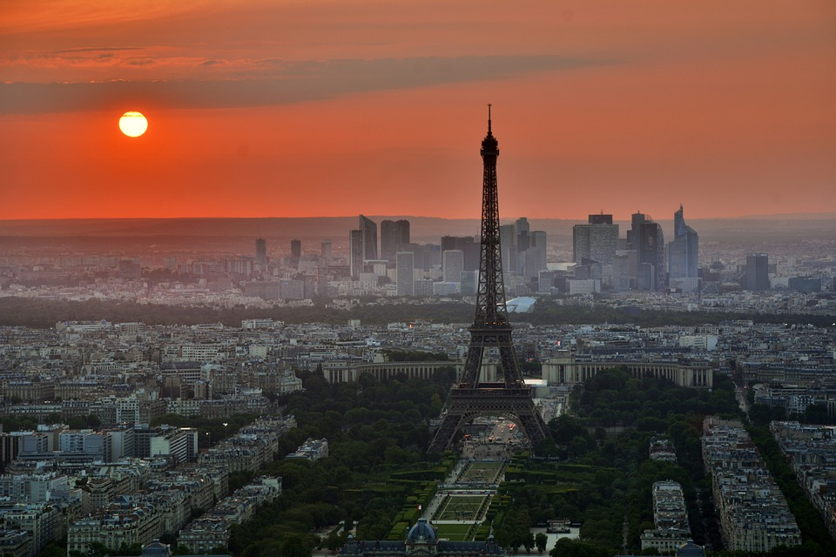
French PowerShell Saturday
Questions?

